Slide 1
State Management and API
By Prof. Soleha A Sayyed

Slide 2
Integration in React
Integration means connecting a React application with external services or APIs.
React can communicate with REST APIs, databases through back-end services, authentication services and other applications.
API integration allows a React UI to send requests and display server data.
Basic flow
User performs an action or page loads
React sends an API request
Server processes the request
Server returns a response
React updates state and displays the data
Example: React → API → JSON response → State → UI

Slide 3
Example: Simple API Integration
const [users, setUsers] = useState([]);
useEffect(() => {
fetch('https://example.com/users')
.then(res => res.json())
.then(data => setUsers(data));
}, []);

Slide 4
Context API in React
Context API in React provides a way to share data globally across components without prop drilling. It allows creating a lightweight global state accessible by any component.
Enables global state management without third-party libraries.
Avoids prop drilling in deeply nested components.
Created using React.createContext().
Ideal for sharing themes, user info, or settings across the app.
Purpose of Context API
Context API prevents prop drilling by providing global state accessible anywhere, simplifying state management and improving performance.
Avoids passing props through multiple layers.
Creates global variables for all components.
Boosts performance by reducing re-renders.
Easier and lighter than Redux.

Slide 5
Working
To work with Context API we need React.createContext().
It has two properties Provider and Consumer.
The Provider acts as a parent it passes the state to its children whereas the Consumer uses the state that has been passed.
Provider: This is used to provide the context to components.
Consumer: This is used to consume the context value in child components.
Steps to Implement Context API in React
Step 1: Create a React application using the following command.
npx create-react-app context-api-demo
Step 2: After creating your project folder(i.e. project), move to it by using the following command.
cd context-api-demo
Step 3: We will create two new files one is Context.js to create our context and another file named as WelcomePage.js for creating a component that will consume the context.

Slide 6
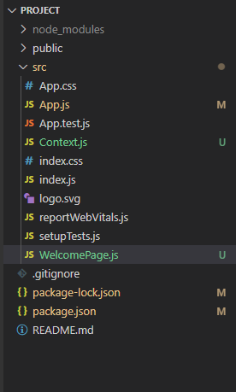
Project Structure

Slide 7
Example:
// App.js
import React from 'react';
import WelcomePage from './WelcomePage';
import UserProvider from './Context';
const App = () => {
return (
<UserProvider>
<WelcomePage />
</UserProvider>
);
};
export default App;
// index.js
import React from 'react';
import ReactDOM from 'react-dom';
import './index.css';
import App from './App';
ReactDOM.render(
<React.StrictMode>
<App />
</React.StrictMode>,
document.getElementById('root')
);

Slide 8
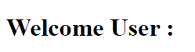
// Context.js
import React, { createContext } from 'react';
export const UserContext = createContext();
const UserProvider = ({ children }) => {
const user = { name: 'John Doe', id: 1 };
return (
<UserContext.Provider value={user}>
{children}
</UserContext.Provider>
);
};
export default UserProvider;
import React, { useContext } from 'react';
import { UserContext } from './Context';
const WelcomePage = () => {
const { user } = useContext(UserContext);
return (
<div>
<h1>Welcome User:</h1>
<p>Name: {user.name} id: {user.id}</p>
</div>
);
};
export default WelcomePage;
Output

Slide 9
Benefits of Context API over React Redux
Context API is simpler, maintains one-way data flow, and allows multiple stores compared to Redux’s single store.
Less boilerplate and fewer files to update.
Maintains React’s one-way data binding.
Supports multiple contexts/stores.
Easier and lighter than Redux.

Slide 10
Introduction to Redux:
Redux is a state management library used in JavaScript applications.
It stores all application data in a single central store, making the data flow predictable and easy to manage.
Redux is especially useful when we need to:
Manage complex application state
Share data between many components
Track and debug state changes easily
Build scalable and well-structured applications
Principles of Redux
Single Source of Truth: The entire application state is stored in a single store, making data consistent and easier to debug.
State is Read-Only (Immutability): State cannot be modified directly; instead, a new state object is created for every change.
Changes via Pure Functions (Reducers): Reducers are pure functions that take the previous state and an action, then return a new updated state.

Slide 11
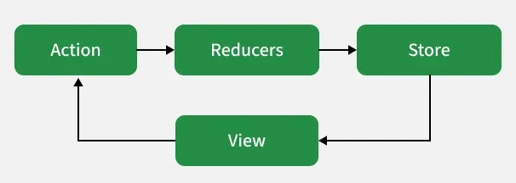
Building Parts of redux
Redux is built using core components like the store, actions, and reducers, which work together to manage and update application state in a predictable way.

Slide 12
Fetch API and Axios
Fetch and Axios are commonly used in web applications to make HTTP requests from the frontend to the backend.
While Fetch is built into modern browsers, Axios is a popular library known for its simplicity and extra features.
Both can handle the same tasks like sending and receiving data.
What is Fetch?
The Fetch API is a built-in JavaScript feature available in modern browsers.
It provides a simple way to make network requests using the fetch() method, which is part of the window object.
This method returns a Promise that resolves with the response to the request.
Syntax:
fetch('url-to-resource') .then(response => { // Handle the response here }) .catch(error => { // Handle errors here });

Slide 13
What is Axios?
Axios is a third-party JavaScript library designed for making HTTP requests. It works with both Node.js and browsers.
Like Fetch, Axios uses the Promise API introduced in ES6.
Axios is known for its simplicity and extra features, such as request/response interception, error handling, and support for cancellation.
Syntax:
axios.get('url')
.then((response) => {
// Code for handling the response
})
.catch((error) => {
// Code for handling the error
})

Slide 14
Difference Between Axios and Fetch
Axios | Fetch
Third-party library that needs installation. | Built-in browser API, no installation needed.
Request URL is included in the request/response object. | You manually define and track the URL.
Has built-in XSRF protection. | No built-in XSRF protection.
Uses data to send and receive content. | Uses body for sending data.
Sends JavaScript objects directly. | Data must be stringified using JSON.stringify().
Automatically parses JSON responses. | You must call .json() to parse the response.
Supports request timeout and cancellation. | Supports cancellation via AbortController, but no built-in timeout.
Built-in support for download/upload progress. | No built-in progress support.
Widely supported in all browsers. | Supported in modern browsers only (Chrome 42+, Firefox 39+, Edge 14+, Safari 10.1+).

Slide 15
Handling Asynchronous data
Asynchronous data is data that takes some time to arrive, usually from an API, database, or server.
React applications commonly handle asynchronous operations using useEffect(), useState(), and APIs such as Fetch API or Axios.
1. Why is asynchronous data needed?
Fetching student details from a server
Loading products from an online store
Getting weather information
Sending form data to a server
Reading data from a database through an API
Common flow
React Component
↓
Send API Request
↓
Waiting...
↓
Receive Response
↓
Store Data in State
↓
Re-render Component

Slide 16
Example:
import React, { useState, useEffect } from "react";
function App() {
const [users, setUsers] = useState([]);
useEffect(() => {
fetch("https://jsonplaceholder.typicode.com/users")
.then(response => response.json())
.then(data => {
setUsers(data);
});
}, []);
return (
<div>
<h2>User List</h2>
{users.map(user => (
<p key={user.id}>{user.name}</p>
))}
</div>
);
}
export default App;

Slide 17
Handling Error using React useState and useEffect Hooks
Handling error states in React ensures a smooth user experience during data fetching and asynchronous operations.
Helps manage unexpected errors in applications.
Improves application stability and reliability.
Ensures smooth user experience during failures.
Allows graceful handling of asynchronous operations.
Error States
Error states occur when unexpected issues arise in an application, often during asynchronous operations like data fetching, due to network failures, server errors, or invalid data.
Approach to handle Error States
To use useState and useEffect , import it from the react library at the top of your component file:
import React, { useState,useEffect } from 'react';

Slide 18
React useState Hook Syntax
const [error, setError] = useState(null);
The useEffect hook syntax accepts two arguments where the second argument is optional
React useEffect Hook Syntax
useEffect(<FUNCTION>, <DEPENDECY>)
FUNCTION: It contains the code to be executed when useEffect triggers.
DEPENDENCY: It is an optional parameter, useEffect triggers when the given dependency is changed.

